Slide 1
Software Testing
Spring 2022
Lecture 2

Slide 2
Software
What is Software?

Slide 3
Software
The IEEE definition of software, which is almost identical to the ISO definition (ISO, 1997, Sec. 3.11 and ISO/IEC 9000-3 Sec. 3.14), lists the following four components of software:
■Computer programs
■Procedures
■Documentation
■Data necessary for operating the software system.

Slide 4
All four components are needed in order to assure the quality of the software development process.

Slide 5
Software quality
Software quality is:
1. The degree to which a system, component, or process meets specified requirements.
2. The degree to which a system, component, or process meets customer or user needs or expectations.

Slide 6
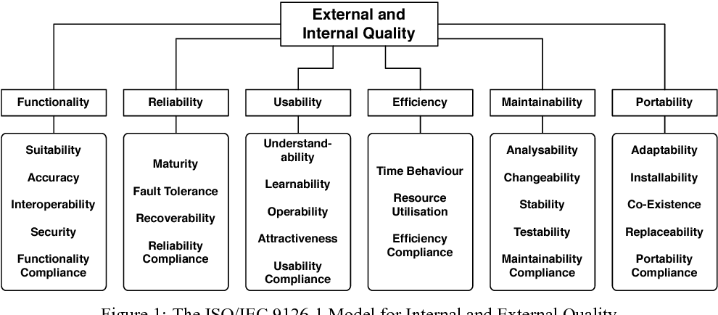

Slide 7
Characteristics of Quality
External
Correctness, Usability, Efficiency, Reliability, Integrity, Adaptability, Accuracy, Robustness
Internal
Maintainability, Readability, Testability, Reusability, Portability, Flexibility, Understandability
Notes:
Software has both external and internal quality characteristics. External characteristics
are characteristics that a user of the software product is aware of, including the following:

Slide 8

Correctness
Notes:
The degree to which a system is free from faults in its specification,
design, and implementation.

Slide 9
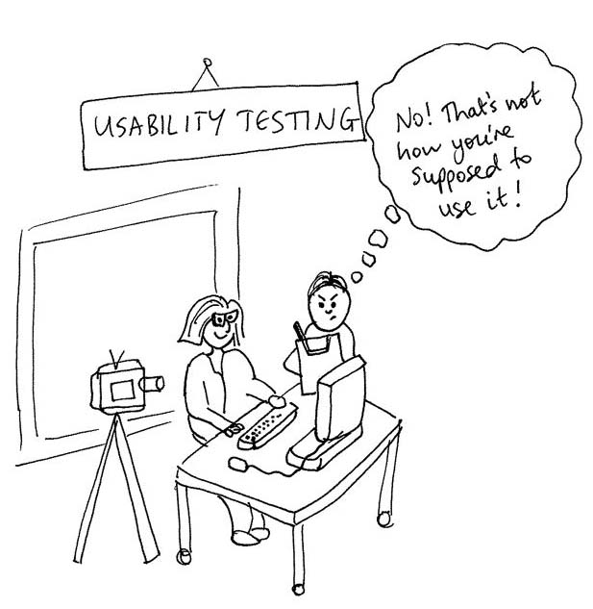
Usability
Notes:
The ease with which users can learn and use a system.

Slide 10

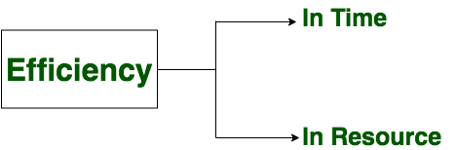
Notes:
Minimal use of system resources, including memory and execution
time.

Slide 11
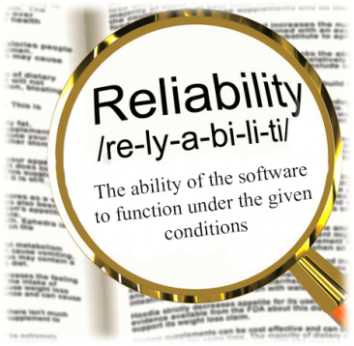
Reliability
Mean time between failures.
Notes:
The ability of a system to perform its required functions under
stated conditions whenever required—having a long mean time between failures.

Slide 12

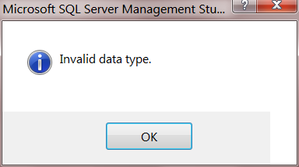

Integrity
Notes:
The degree to which a system prevents unauthorized or improper
access to its programs and its data. The idea of integrity includes restricting
unauthorized user accesses as well as ensuring that data is accessed properly—
that is, that tables with parallel data are modified in parallel, that date fields contain
only valid dates, and so on…

Slide 13
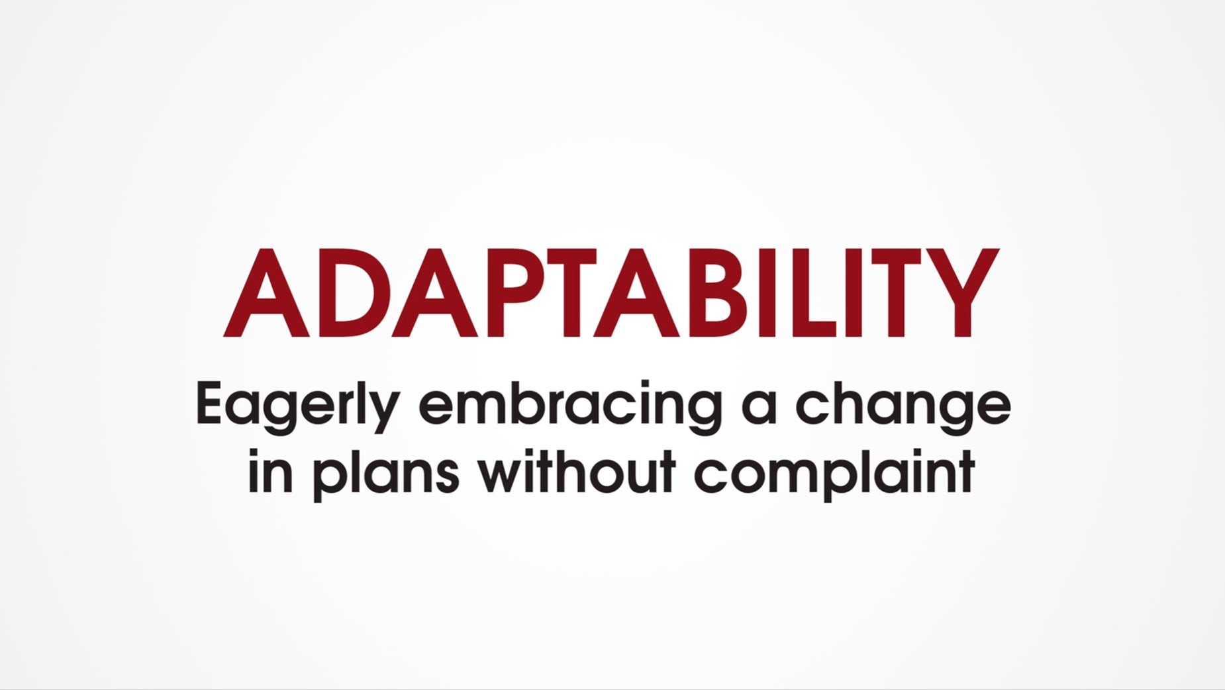

Adaptability
Notes:
The extent to which a system can be used, without modification,
in applications or environments other than those for which it was specifically
designed.

Slide 14
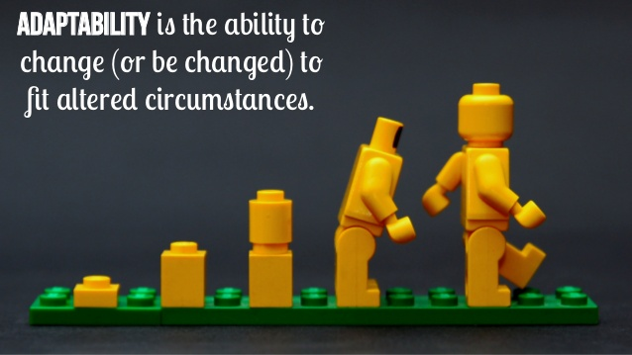


Slide 15

Accuracy
Notes:
The degree to which a system, as built, is free from error, especially
with respect to quantitative outputs. Accuracy differs from correctness; it is a
determination of how well a system does the job it’s built for rather than
whether it was built correctly.

Slide 16
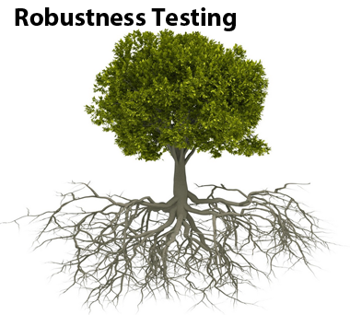
Robustness
Notes:
The degree to which a system continues to function in the presence
of invalid inputs or stressful environmental conditions.

Slide 17
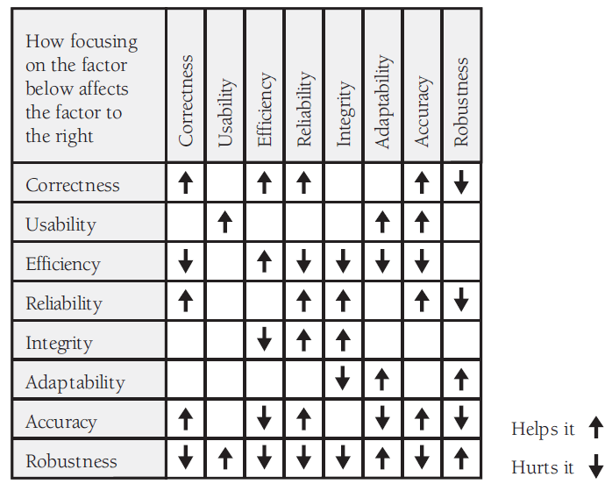
Notes:
Focus on adaptability helps robustness
Focus on correctness hurts robustness

Slide 18

Maintainability
Add features
Remove defects
Improve performance
Change features
Notes:
The ease with which you can modify a software system to
change or add capabilities, improve performance, or correct defects.

Slide 19
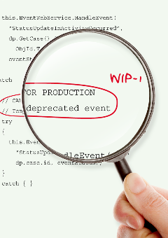
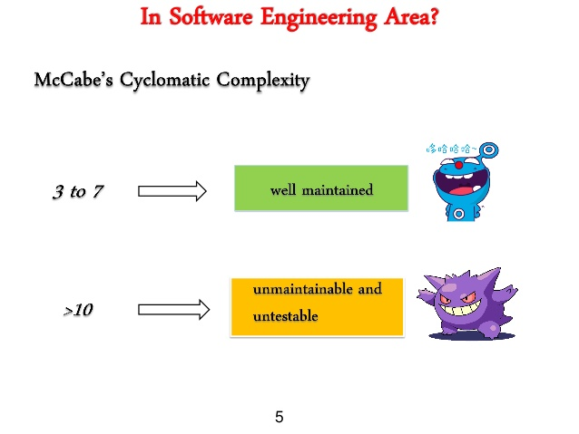
Maintainability

Slide 20

Flexibility
An interface for visually impaired needs to be added
Warehouse inventory → hotel management system
Notes:
The extent to which you can modify a system for uses or environments
other than those for which it was specifically designed.

Slide 21

Portability
Same app for different OS/HW.
Some other examples ??
Notes:
The ease with which you can modify a system to operate in an
environment different from that for which it was specifically designed.

Slide 22
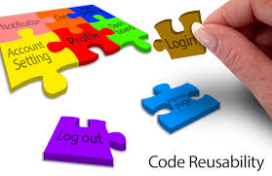
Reusability
Notes:
The extent to which and the ease with which you can use parts of
a system in other systems.

Slide 23


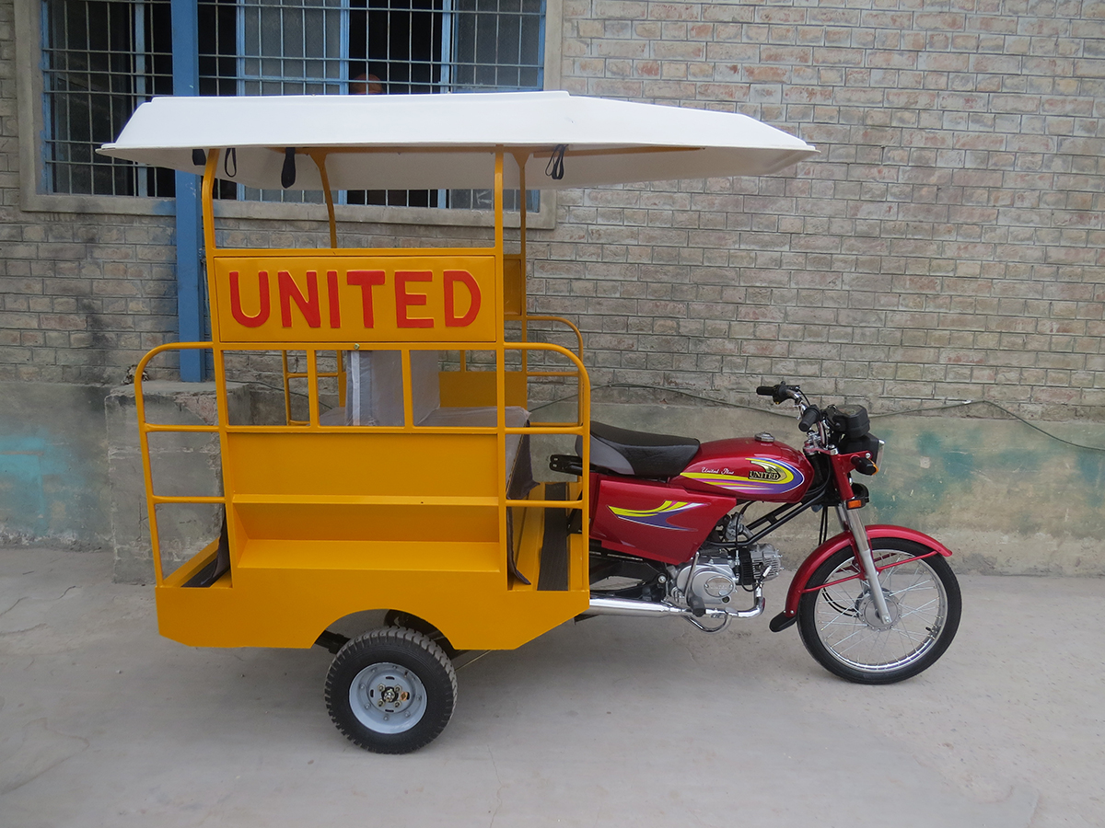
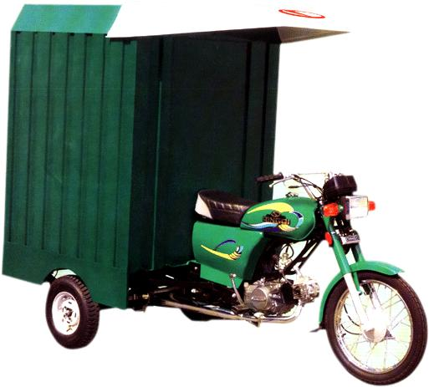

Slide 24
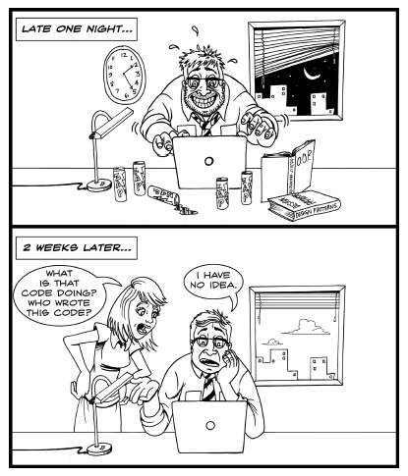
Readability
Notes:
The ease with which you can read and understand the source
code of a system, especially at the detailed-statement level.

Slide 25

Testability
Notes:
The degree to which you can unit-test and system-test a system;
the degree to which you can verify that the system meets its requirements.

